Slide 1

TECHNICAL SEMINAR ON DEEP SPACE NETWORK
Presented by:
Suraj Kumar
Reg. 1701227473
Sec- ETC 2B
Department of Electronics & Telecommunication Engineering
C.V. Raman College of Engineering

Slide 2
Contents
Introduction
Problem Statement
Principle
Explanation
Applications
References

Slide 3
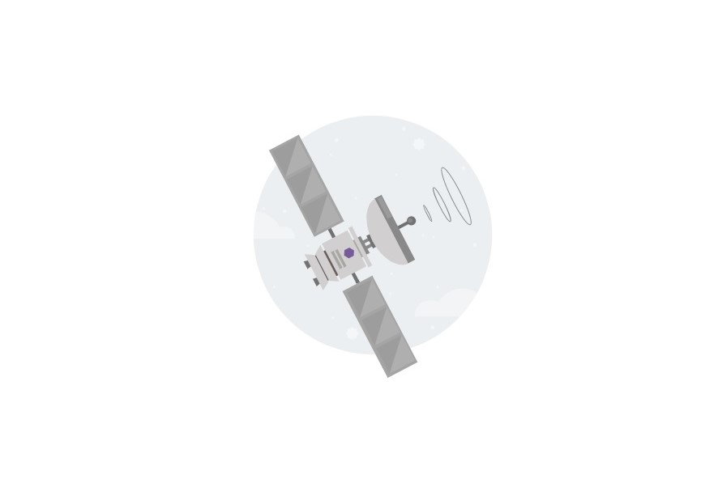
An Overview to the life line of Space Communication
Why do we need DSN?
Communicating in space is hard due to large distance between the communicating elements (spacecrafts)
Different type of noises comes along with signal transfer
An idealistic communication network with continuous linkage between Earth and the space elemets will enable us to carry out scientific missions at any space location for required duration of time

Slide 4
What do we mean by Deep Space Network?
A communication network between earth and space elements that are above the earth's top most atomspheric layer
The top most layer consist of exosphere that extends from 500km-10000km above the earth's surafce

Slide 5
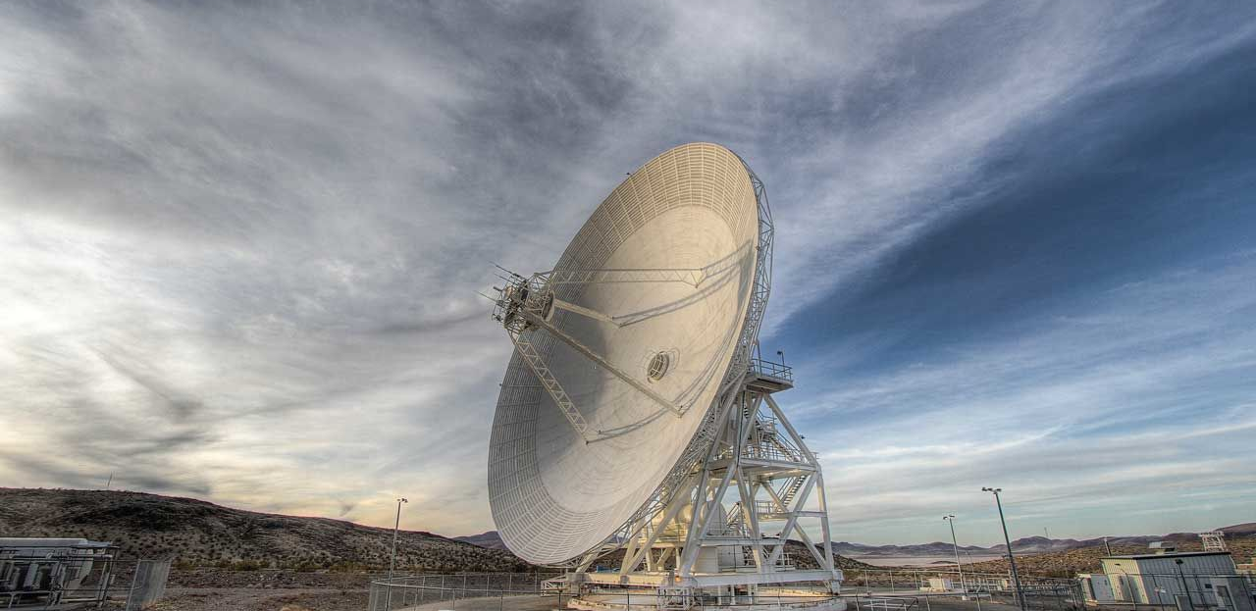
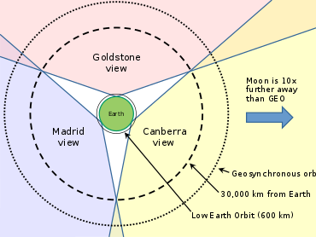
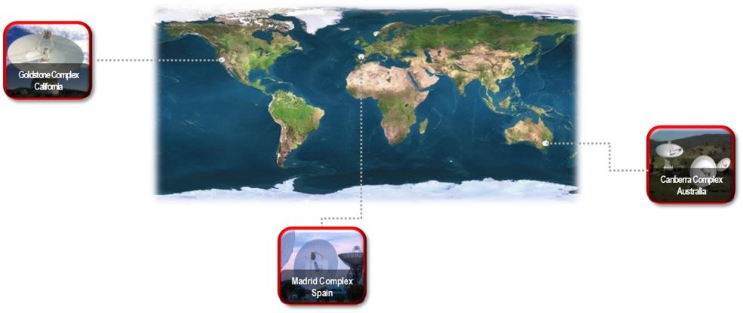
How does the DSN comes alive?
Ref-1

Slide 6
Working of DSN
The DSN consists of three facilities spaced equidistant from each other – approximately 120 degrees apart in longitude – around the world
These sites are at Goldstone, California; Madrid, Spain; and Canberra, Australia
The strategic placement of these sites permits constant communication with spacecraft as our planet rotates
It works as before a distant spacecraft sinks below the horizon at one DSN site, another site can pick up the signal and carry on communicating

Slide 7
The large antennas amplifies the lowest strength signals. And they are designed to work at very low temperatures (few degrees above the absolute zero temperature)
Another way the DSN amplifies the communication is by using multiple antennas to collect the signal from same source
Arraying- works good for signals having large wavelenghts like radio waves).

Slide 8
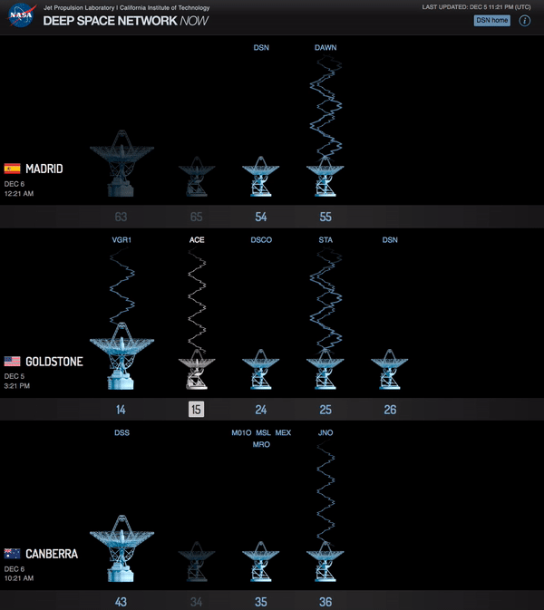
DSN Antennas
Ref-2

Slide 9
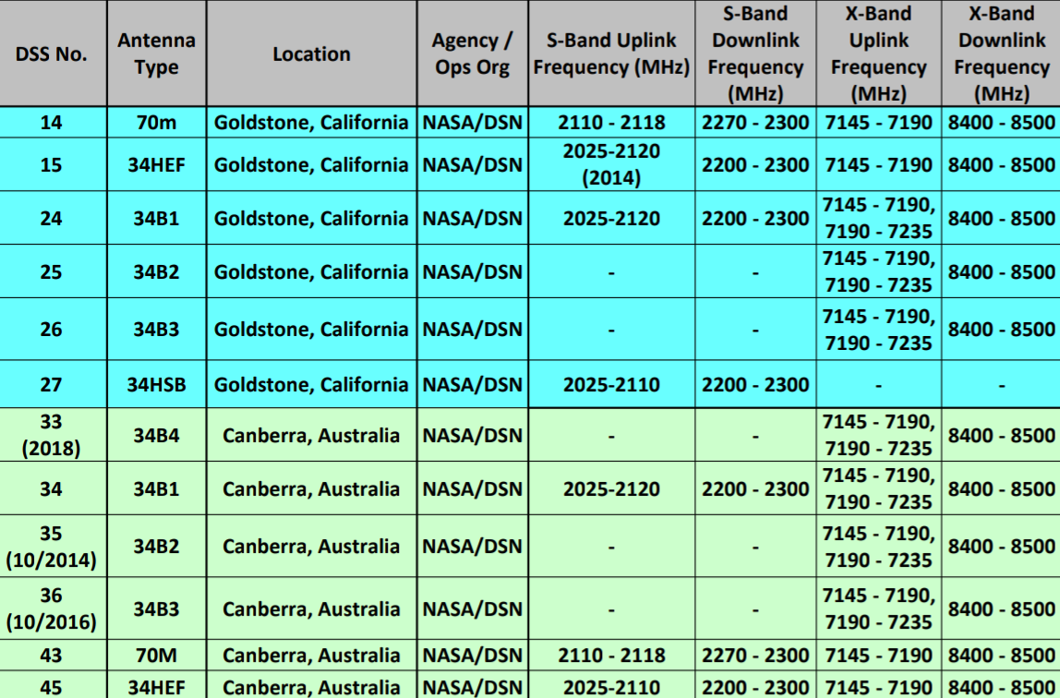
Frequency assignment of antenna
Ref-2(a)

Slide 10
Noise in Deep Space Communication
There are lot of factors and parameters that comes in communication with deep space
These include objects behind the spacecraft, atmosphere, how well does communication work with antennas and spacecraft, interference & noise
Out of these factors distance is also an important parameter that makes deep space communication different from other communication network
Noise created by the antenna itself in the form of infrared radiation

Slide 11
Signal strength
Place | Distance | Difficulty
Geo- Satellite | 4*10⁴ Km | Baseline
Moon | 4*10⁵ Km | 100
Mars | 3*10⁸ Km | 5.6*10⁷ Km
Jupiter | 8*10⁸ Km | 4*10⁸ Km
Pluto | 5*10⁹ Km | 1.6*10¹⁰ Km
Ref-3

Slide 12
Locating a Spacecraft using DSN
Doppler
Increase (or decrease) in the frequency of a wave as the source and observer move towards (or away from) each other
The effect causes the sudden change in pitch noticeable in a detector
Doppler= (uplink frequency-downlink frequency)
transponding ratio
There are three types of doppler measurement in DSN- one way, two way & three way measurement

Slide 13
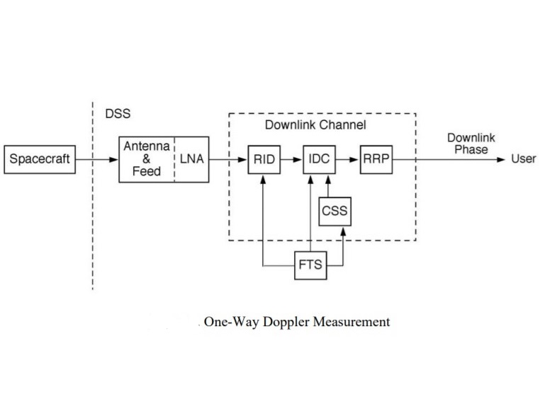
One-Way Doppler

Slide 14
Differential One-way Ranging
It is an interplanetary radio-tracking and navigation technique
Radio signals from the spacecraft are received by two widely separated deep-space ground stations on earth
The difference in the times of signal arrival is precisely measured
This is corrected using information about the current delays due to Earth’s atmosphere, obtained by simultaneously tracking (from each ground location)

Slide 15
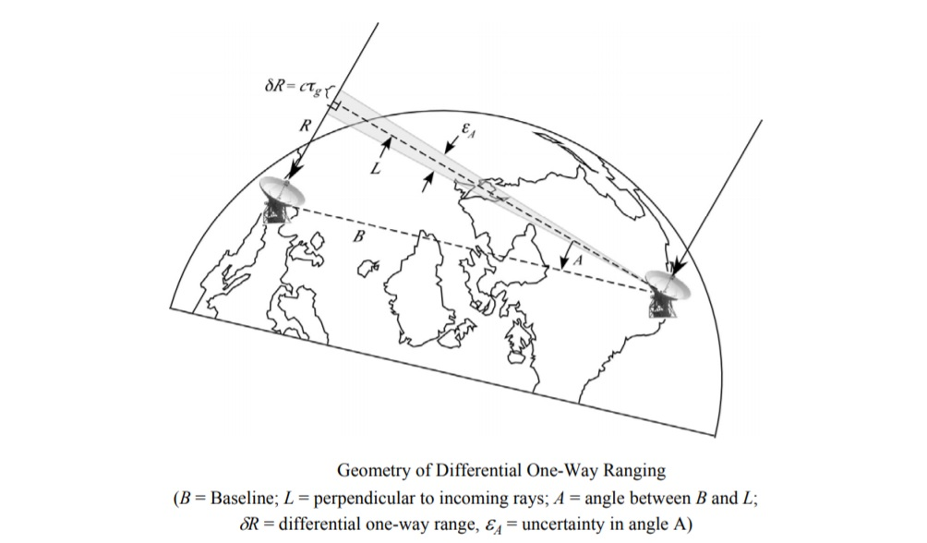
Differential One-way ranging

Slide 16
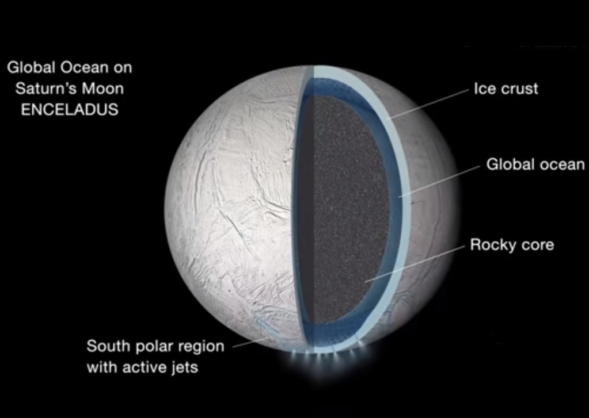
Applications
Telemetry
Telemetry data is made up of crucial science and engineering information transmitted to Earth via radio signals from spacecraft
They explore the far reaches of our solar system. The Deep Space Network, or DSN acquires, processes, decodes and distributes this data
Ref-4

Slide 17
Spacecraft Command
Space mission operations teams use the DSN Command System to control the activities of their spacecraft
Commands are sent to robotic probes as coded computer files that the craft execute as a series of actions
Tracking
The DSN Tracking System provides two-way communication between Earth-based equipment and a spacecraft
Making measurements that allow flight controllers to determine the position and velocity of spacecraft with great precision

Slide 18
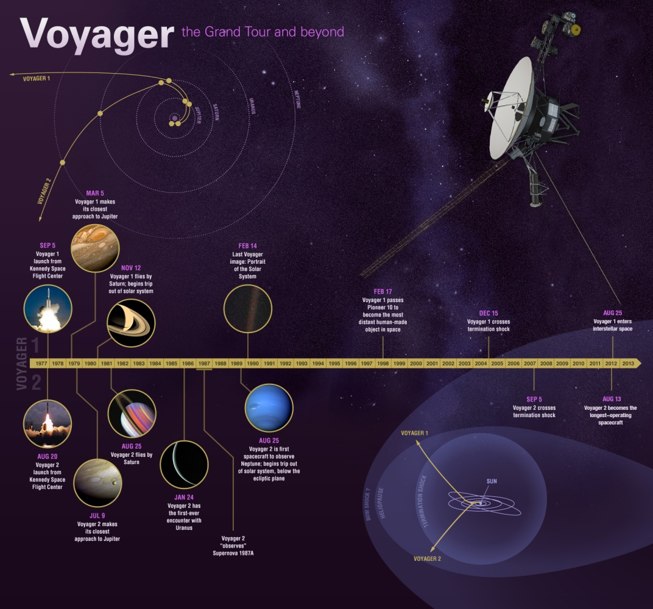
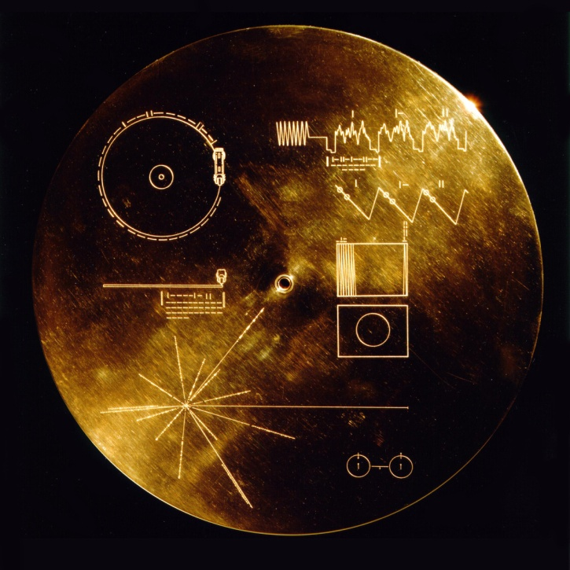
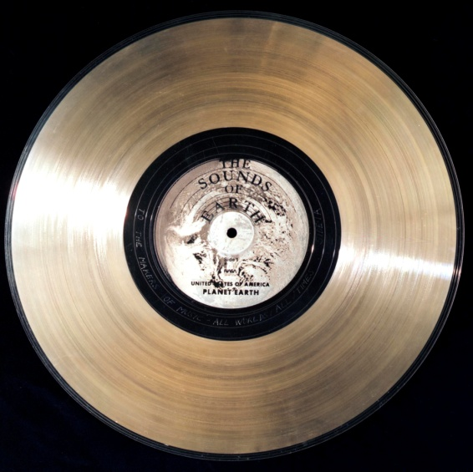
Farthest the DSN has ever reached
Ref-5

Slide 19
References
Chang, C. "DSN Telecommunications Link Design Handbook." DSN Document 373.810–005 (2015)
J. Border "Delta-Differential One-Way Ranging" 810–005 DSN Telecommunications Link Design Handbook (2013)
Deep Space Network: A discussion on Nasa's vital lifeline to spacecraft, by Dr. Lewis doich (Deputy director of Interplanatery Network Directorate)
Ref-1: https://deepspace.jpl.nasa.gov/about/
Ref-2: https://eyes.nasa.gov/dsn/dsn.html

Slide 20
References
Ref-2(a): https://pdfs.semanticscholar.org/18aa/
Ref-3: https://youtu.be/9vYdfsy4l5Y
Ref-4: https://solarsystem.nasa.gov/missions/cassini/overview/
Ref-5: https://voyager.jpl.nasa.gov/

Slide 21
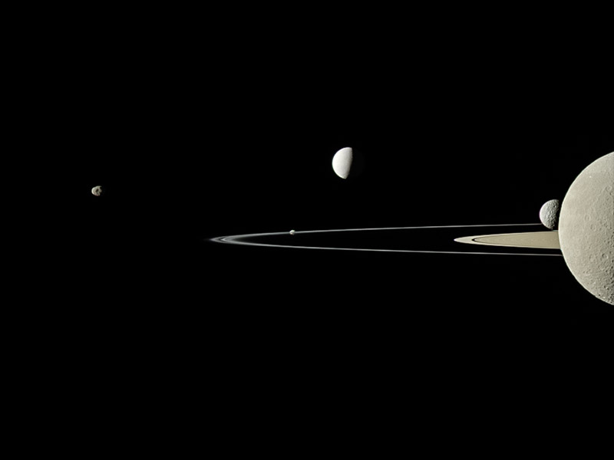
T h a n k y o u f o r l i s t e n i n g
t h e s o u n d s o f t h e u n i v e r s e

